Slide 1
HPX Workshop (4)
Berkeley C++ Summit 2016

Slide 2
Agenda
How to build HPX
How to build applications using HPX
How to run HPX applications
Architecture of HPX
The API of HPX
Futures, etc.
Async, etc.
Higher level parallel constructs
Execution policies, executors, parameters, targets
Examples
Hello world!
Real world problems
Fibonacci (parallelism for recursive algorithms)
2d stencil (parallelism for iterative algorithms)
Matrix transpose (parallelism for fork-join algorithms)

Slide 3
2D Stencil Example
Parallelism for Iterative Algorithms

Slide 4
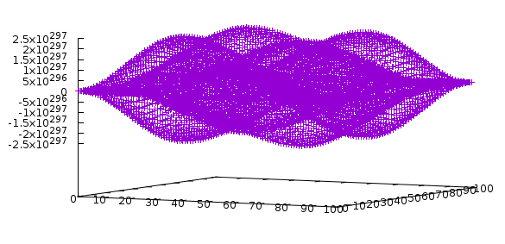
"Solving" a PDE on a 2D Grid
DISCLAIMER: This has no real physics or mathematical background. Left as an exercise for the reader ;)
Running a 5 point stencil on each element:
Boundaries are constant and equal to 1
Update function
new(x,y) = 0.25 * (
old(x-1,y) + old(x+1,y) +
old(x,y-1) + old(x,y+1)
) - old(x,y)

Slide 5
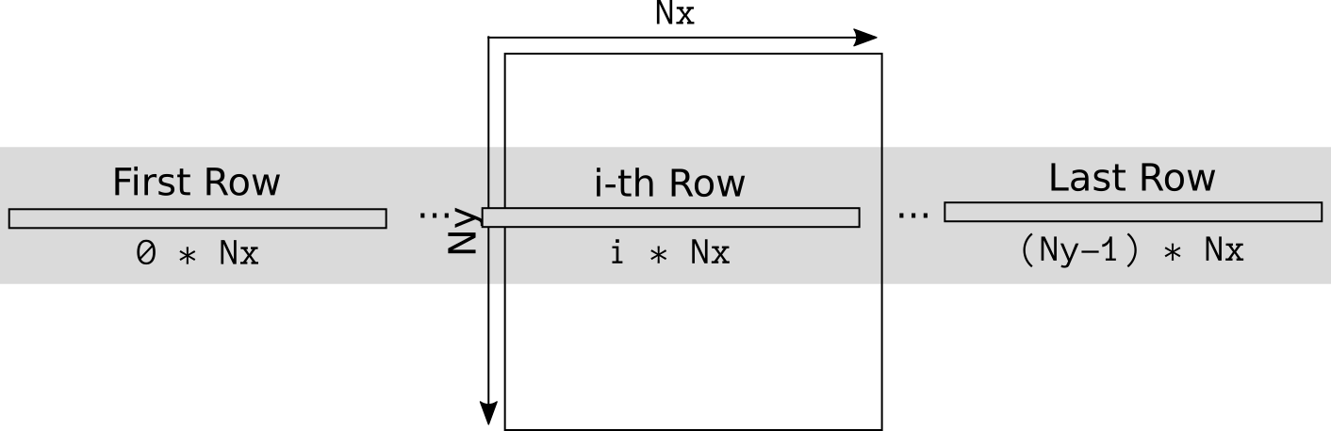
"Solving" a PDE on a 2D Grid
Store 2D grid as a 1D array: std::vector<double>

Slide 6
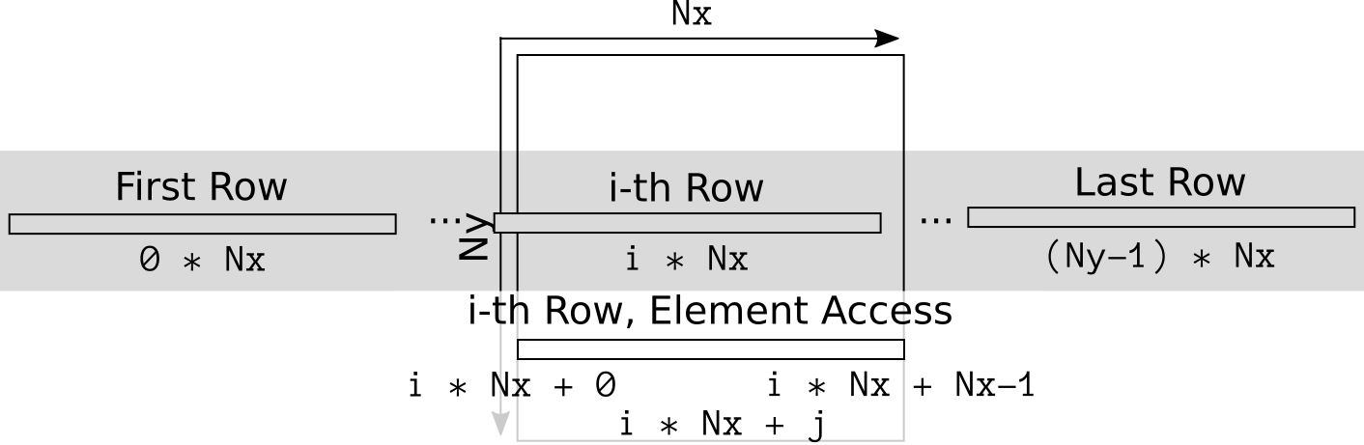
"Solving" a PDE on a 2D Grid
Store 2D grid as a 1D array: std::vector<double>

Slide 7

"Solving" a PDE on a 2D Grid
We want to update line by line
Each line needs its upper and lower neighbor
Introduce special line_iterator which holds iterators referring to three consecutive lines in the grid
Incrementing that iterator increments all three, etc.
-1
+1
up
middle
down

Slide 8
"Solving" a PDE on a 2D Grid
We want to update line by line, each line needs its upper and lower neighbor
template <typename InIter, typename OutIter>
OutIter line_update(InIter begin, InIter end, OutIter result)
{
++result; // skip first element (boundary)
// Iterate over the interior
for(InIter it = begin + 1; it != end - 1; ++it, ++result)
*result = 0.25 * (it.up[-1] + it.up[+1] + it.down[-1] + it.down[+1]) + *it.middle;
++result; // skip last element (boundary)
return result;
}

Slide 9
"Solving" a PDE on a 2D Grid
std::vector<double> d1(Nx * Ny, 0.0), d2(Nx * Ny, 0.0); // data arrays
init(d1, Nx, Ny); // initial conditions
iterator curr(Nx, d1.begin()), next(Nx, d2.begin()); // column iterators
for (std::size_t t = 0; t != steps; ++t)
{
// We store the result of our update in the next middle line.
auto result = next.middle + Nx; // skip the first row.
// Iterate over the interior
for(auto it = curr + 1; it != curr + Ny - 1; ++it)
result = line_update(*it, *it + Nx, result);
// Prepare next time-step: result of previous is now source of next
std::swap(curr, next);
}

Slide 10
"Solving" a PDE on a 2D Grid
Full source code of sequential version: https://github.com/STEllAR-GROUP/tutorials/blob/master/examples/02_stencil/stencil_serial.cpp

Slide 11
"Solving" a PDE in Parallel
auto policy = hpx::parallel::par; // simple, parallel execution
for (std::size_t t = 0; t != steps; ++t)
{
// We store the result of our update in the next middle line.
hpx::parallel::for_loop(policy,
curr + 1, curr + Ny-1, // [begin, end)
// We need to advance the result by one row each iteration
hpx::parallel::induction(next.middle + Nx, Nx), // [start, stride]
[Nx](iterator it, std::vector<double>::iterator result)
{
line_update(*it, *it + Nx, result);
}
);
std::swap(curr, next);
}

Slide 12
"Solving" a PDE in Parallel
Full source code of sequential version: https://github.com/STEllAR-GROUP/tutorials/blob/master/examples/02_stencil/stencil_parallel_0.cpp
Pro:
Parallelized outer loop
Simple!
Cons:
Implicit join after each time step
No NUMA awareness, possibly not optimal
When running try using command line options: --hpx:print-counter=/threads/idle-rate (measure idle-rate) --hpx:threads=N (N number of cores to use)

Slide 13
"Solving" a PDE, NUMA aware
typedef hpx::compute::host::block_allocator<double> allocator_type;
typedef hpx::compute::host::block_executor<> executor_type;
typedef hpx::compute::vector<double, allocator_type> data_type;
auto numa_domains = hpx::compute::host::numa_domains(); // collect NUMA targets
allocator_type alloc(numa_domains);
data_type d1(Nx * Ny, 0.0, alloc), d2(Nx * Ny, 0.0, alloc); // data arrays
init(d1, Nx, Ny); // initial conditions
executor_type executor(numa_domains);
auto policy = hpx::parallel::par.on(executor);
for (std::size_t t = 0; t != steps; ++t)
{
// as before ...
}

Slide 14
"Solving" a PDE in Parallel
Full source code of sequential version: https://github.com/STEllAR-GROUP/tutorials/blob/master/examples/02_stencil/stencil_parallel_1.cpp
Pro:
Parallelized outer loop
Still simple!
Cons:
Implicit join after each time step

Slide 15
"Solving" a PDE, Distributed
Still NUMA aware on each of the nodes
Distribute 2D grid over localities as stripes
First and last line of each stripe needs to be communicated after each time-step
Also: over-partitioning by having more stripes than localities/cores
Grain-size control!
Apply futurization techniques to increase parallel efficiency
Requires communication between stripes
Some stripes communicate locally
Some stripes (boundaries) communicate remotely
Hugely differing latencies

Slide 16
Channels in HPX
Concept borrowed from Go language
Communication channel for objects of a given type
Two ends: set/get, both optionally asynchronous
Data will retrieved by get() in the same sequence as it was provided by set()
The channel can cross node-boundaries (but does not have to)
Perfect facility for boundary exchange between neighboring partitions

Slide 17
Channels in HPX
void sum(std::vector<int> const& s, hpx::lcos::local::channel<int> c)
{
c.set(std::accumulate(s.begin(), s.end(), 0)); // send sum to channel
}
void calculate_sum()
{
std::vector<int> s = { 7, 2, 8, -9, 4, 0 };
hpx::lcos::local::channel<int> c;
hpx::apply(&sum, std::vector<int>(s.begin(), s.begin() + s.size()/2), c);
hpx::apply(&sum, std::vector<int>(s.begin() + s.size()/2, s.end()), c);
int x = c.get(hpx::launch::sync); // receive from c
int y = c.get(hpx::launch::sync);
hpx::cout << "sum: " << x + y << std::endl;
}

Slide 18
Channels in HPX
void sum(std::vector<int> const& s, hpx::lcos::local::channel<int> c)
{
c.set(std::accumulate(s.begin(), s.end(), 0)); // send sum to channel
}
void calculate_sum()
{
std::vector<int> s = { 7, 2, 8, -9, 4, 0 };
hpx::lcos::local::channel<int> c;
hpx::apply(&sum, std::vector<int>(s.begin(), s.begin() + s.size()/2), c);
hpx::apply(&sum, std::vector<int>(s.begin() + s.size()/2, s.end()), c);
hpx::future<int> x = c.get(hpx::launch::async); // receive from c asynchronously
hpx::future<int> y = c.get(hpx::launch::async);
hpx::cout << "sum: " << x.get() + y.get() << std::endl;
}

Slide 19
"Solving" a PDE, Distributed
// ... as before
auto policy = hpx::parallel::par.on(executor);
for (std::size_t t = 0; t != steps; ++t)
{
handle_receive_boundaries(t, rank);
hpx::parallel::for_loop(policy, curr + 1, curr + Ny-1, // [begin, end)
hpx::parallel::induction(next.middle + Nx, Nx), // [start, stride]
[Nx](iterator it, std::vector<double>::iterator result)
{
line_update(*it, *it + Nx, result);
});
handle_send_boundaries(t, rank);
std::swap(curr, next);
}

Slide 20
"Solving" a PDE, Futurized
// ... as before
auto policy = hpx::parallel::par(task).on(executor);
future<void> all_is_done = make_ready_future();
for (std::size_t t = 0; t != steps; ++t)
{
all_is_done =
all_is_done.then([&](auto f)
{
future<void> receive_done = handle_receive_boundaries(t, rank);
future<void> work_done = hpx::parallel::for_loop(policy, ...);
future<void> send_done = handle_send_boundaries(t, rank);
return when_all(receive_done, work_done, send_done);
}
std::swap(curr, next);
}
all_is_done.get();

Slide 21
"Solving" a PDE, Futurized
Full source code of sequential version: https://github.com/STEllAR-GROUP/tutorials/blob/master/examples/02_stencil/stencil_parallel_4.cpp
Pro:
Parallelized over partitions
Parallelized outer loop
Not much more complex!
No implicit join after each time step

Slide 22
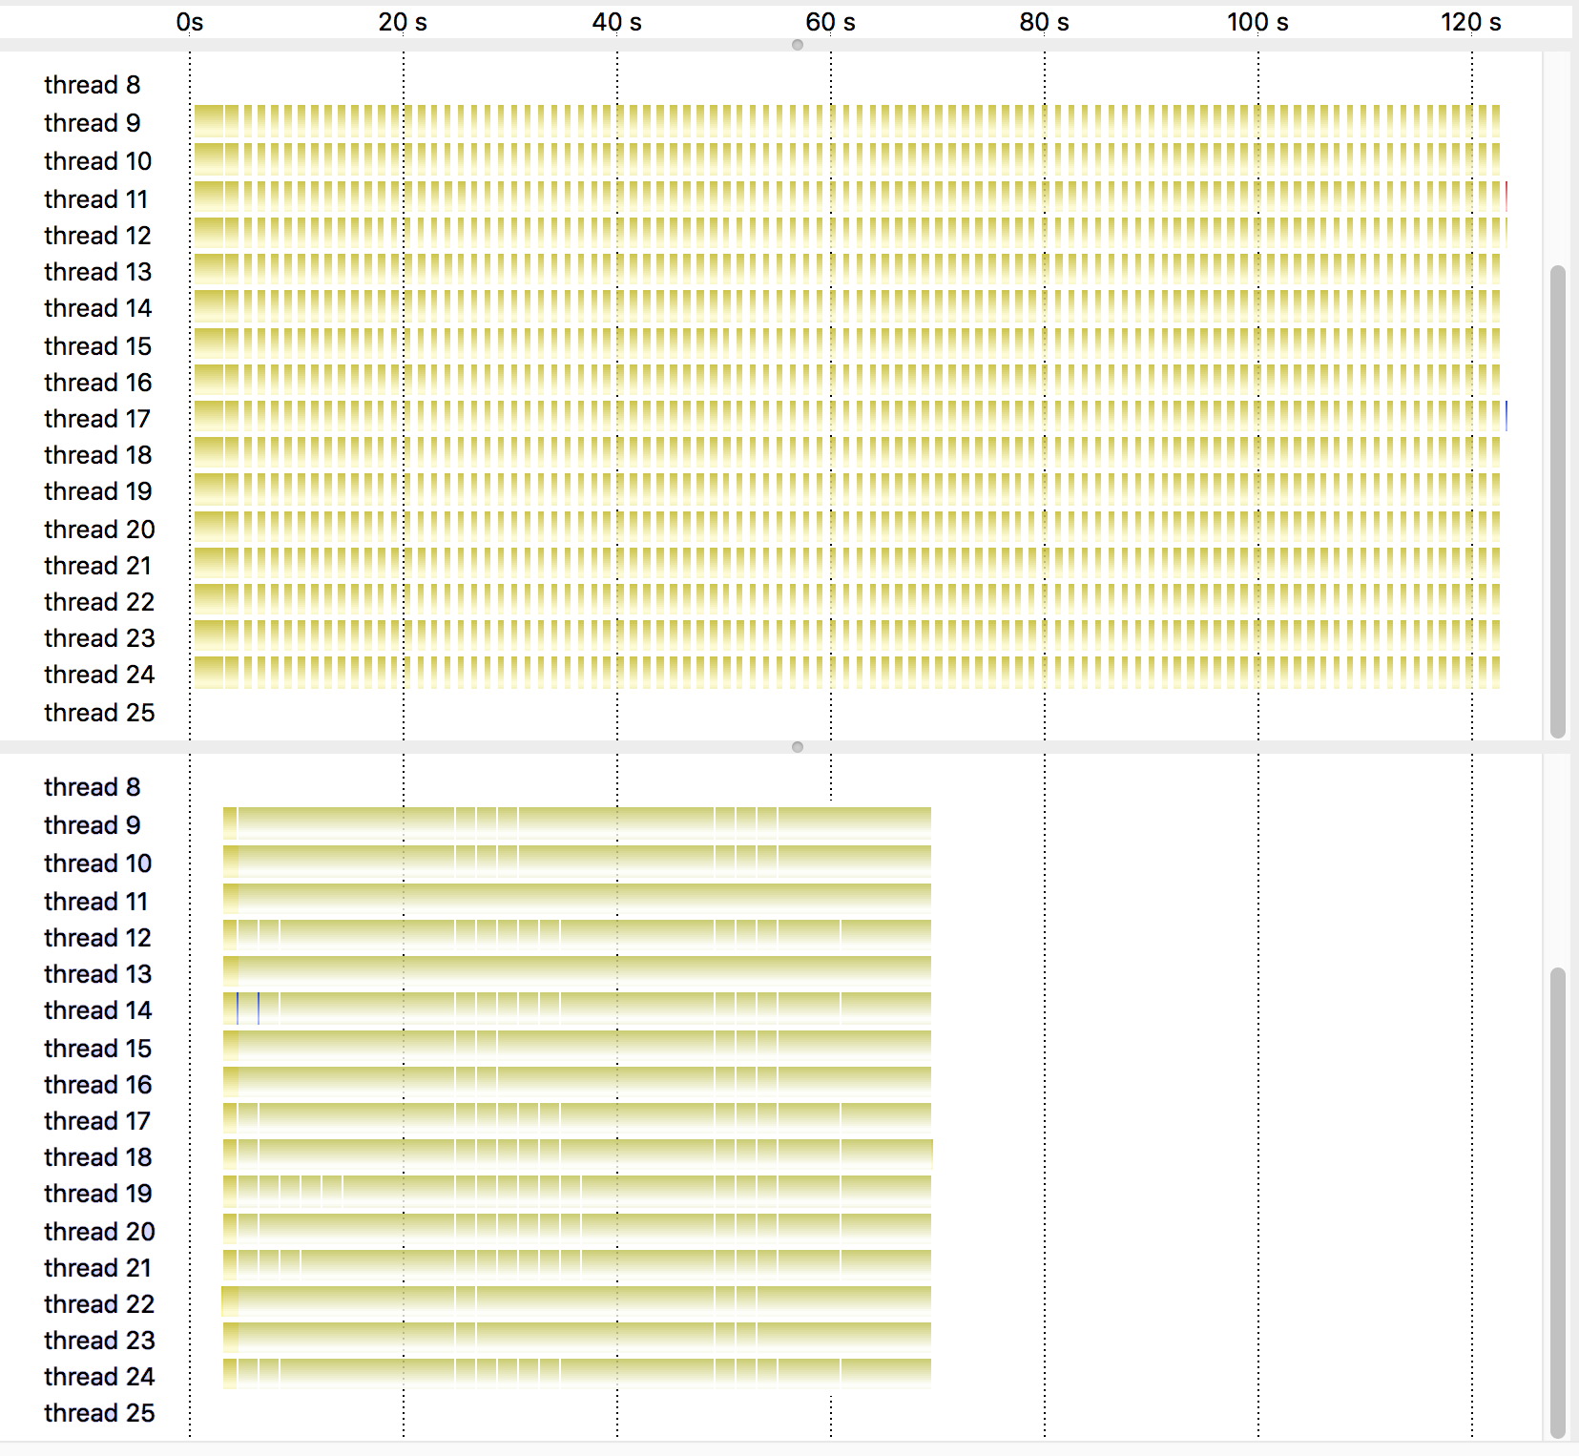
"Solving" a PDE on a 2D Grid
Idle-rate: 48%
Idle-rate: 2%

Slide 23
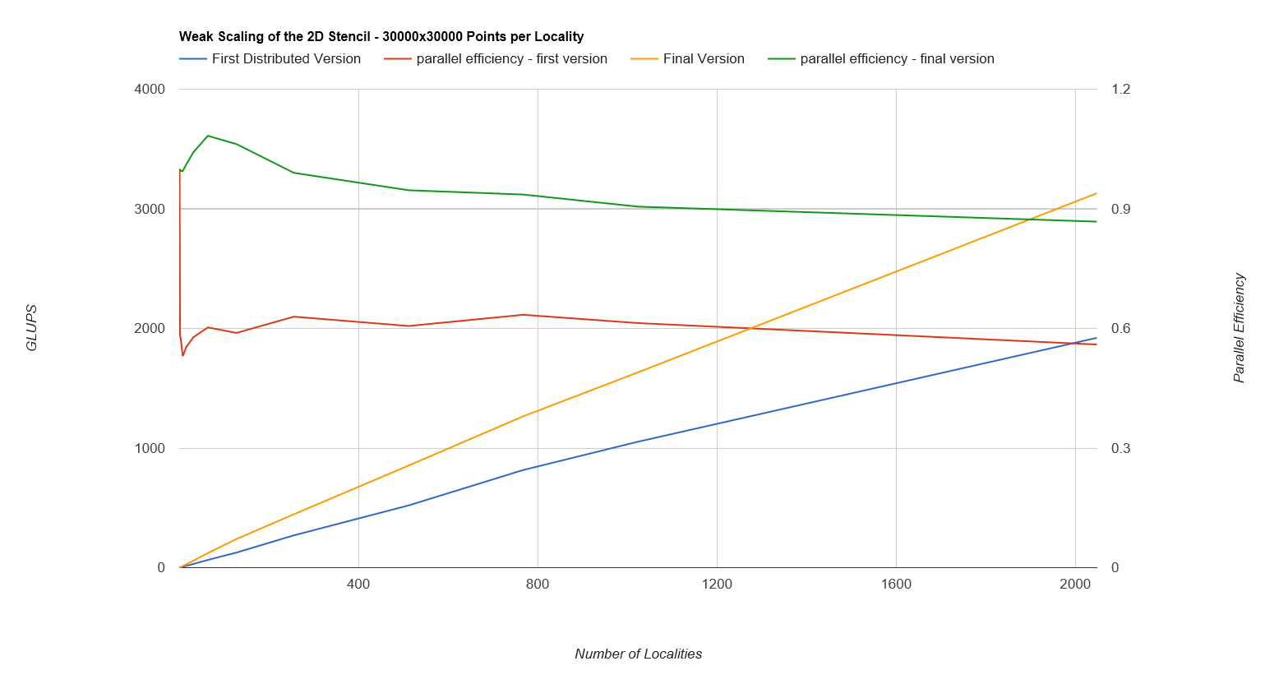
"Solving" a PDE in Parallel

Slide 24
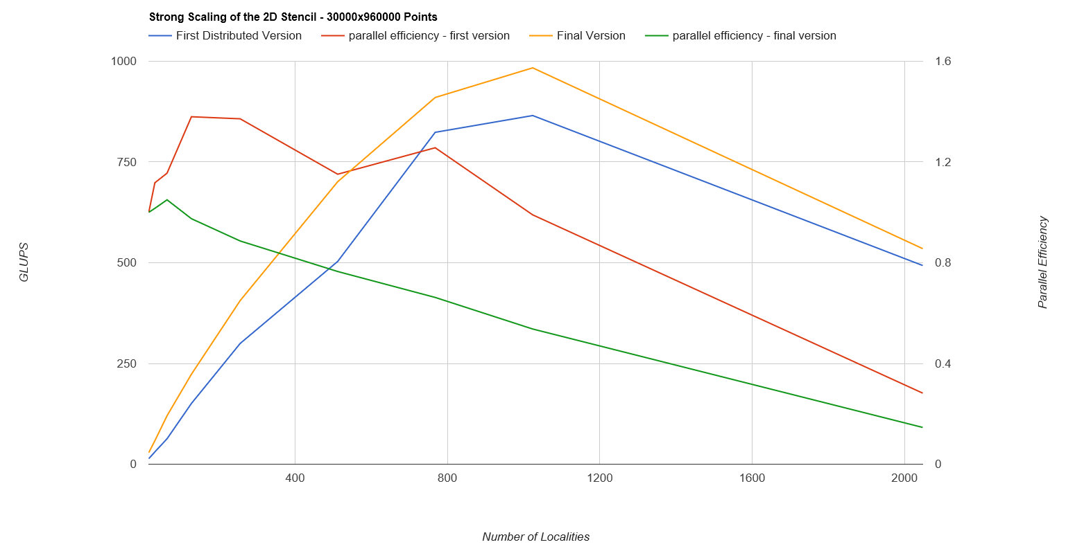
"Solving" a PDE in Futurized

Slide 25
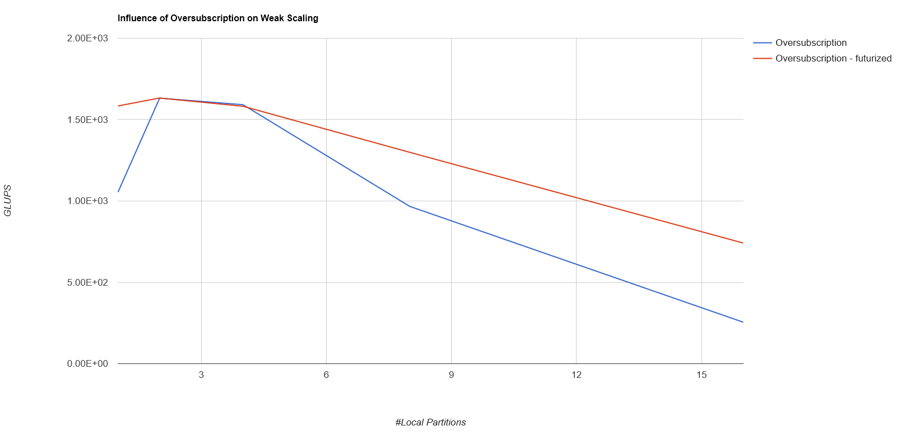
Over-Decomposition

Slide 26
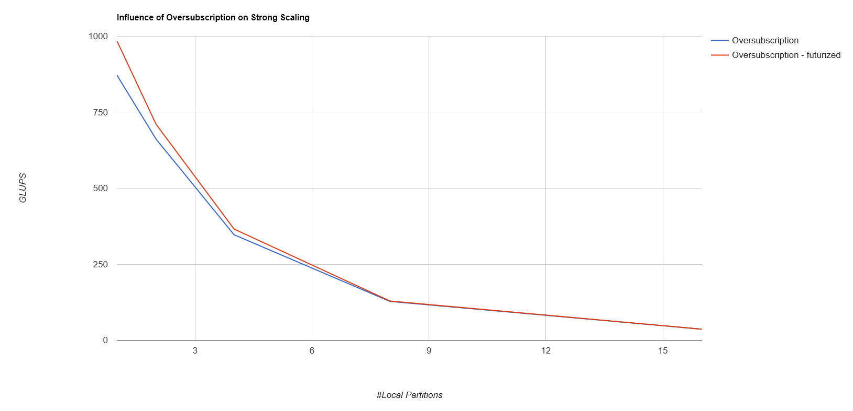
Over-Decomposition

Slide 27
